Slide 1

Data Assimilation with CLM & DART
Tim Hoar: National Center for Atmospheric Research
with a whole lot of help from:
Bill Sacks, Mariana Vertenstein, Tony Craig, Jim Edwards: NCAR
Andrew Fox: National Ecological Observatory Network (NEON)
Nancy Collins, Kevin Raeder, Jeff Anderson: NCAR
Yongfei Zhang: University of Texas Austin
Notes:
Andy thinks half the people will think we are adjusting parameters for the model, not the model states themselves. Need to be very clear that we are making the model states more faithfully represent the actual state of the system as opposed to a climatological representation. Motivation is to put CLM into model states that will enable things like ecological forecasting – in the same way that atmospheric forecasting requires good initial conditions, it stands to reason that land surface forecasting will also benefit from
To use a car racing analogy, I’m sort of the “pit crew” for this effort. Andy, Fei are the drivers and get to use CLM/DART for different scientific purposes, I’m here to make sure CLM/DART performs as expected and does what they need it to do. Make no mistake, Andy and Fei get into the pit and work on CLM/DART too.

Slide 2
Is DA different for NWP and ecosystem models?
 | Data Assimilation in NWP | Data Assimilation in CLM
Main objective | Improved initial conditions Forecast improvement | Process understanding Regional quantification Forecasting
Dynamics | Physics – essentially well known from first principles | Physical, biological, chemical – Only partially known, empirical relationships
Observations | High spatial and temporal density | Very different spatial and temporal characteristics
Mathematical problem | Optimization of initial conditions | Initial value problem (e.g. pools) Boundary conditions (e.g. fluxes) Parameter optimization
Notes:
This slide is one of Andy’s to motivate using DA with CLM.
It explains why my mailbox has emails from perhaps a dozen groups that want to do DA with CLM.
About half those groups are using Noah or other models because CLM is too complicated.
I’m going to go into a quick explanation of what DA is, follow it with an example, and then get into some of the more interesting details.

Slide 3
A generic ensemble filter system like DART needs:
1. A way to make model forecasts.
2. A way to estimate what the observation would be – given the model state. This is the observation operator – h.
The increments are regressed onto as many CLM state variables as you like. If there is a correlation, the CLM state gets adjusted in the restart file.
CLM instances
Notes:
This is a schematic – for clarity it has 3 ensemble members, we typically run wit 40 to 80 ensemble members.
I’m going to use the terms ‘ensemble members’, ’instances’, and ‘model states’ interchangeably.
The instances advance to some time when we want to assimilate some data, CLM writes out a bunch of restart files at time ‘t’.
DART grabs some subset of interest of the restart file to create a DART statevector.
DART applies an observation operator to get the expected value of an observation given the state.
These expected observations are compared to the observation that contains observation error, instrument error, representativeness errors … whatever.
All observations are imperfect.
Increments are calculated and then regressed onto the DART statevector.
The DART statevector elements are then inserted back into the CLM RESTART FILE.
We are not estimating parameters – YET. We are updating the actual CLM state, not the CLM parameters.
The whole point (to me) is that – after cycling the assimilation cycle “a few time” – CLM will represent June 19th 2012 instead of some arbitraryJune 19th.
Now you can do ecological forecasting.
Now you can compare the water storage from a GRACE observation to the water storage estimated by CLM for that day/week …

Slide 4
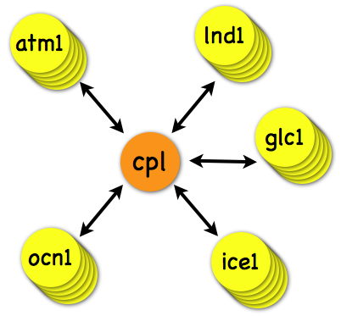
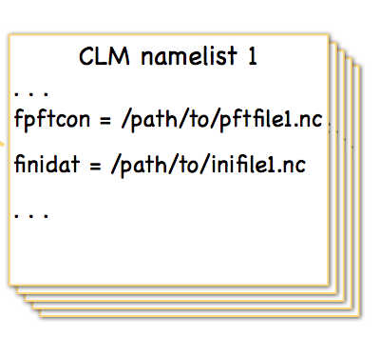
Multi-instance CESM code
A multi-instance version of CESM has been developed that more easily facilitates ensemble-based DA
For example, multiple land models can be driven by multiple data-atmospheres in a single executable.
This capability should be available in the next CESM release.
Right now, this is only available on the development branch!

Slide 5
Creating the initial ensemble of CLM.
Replicate what we have N times.
Use a unique (and different!) realistic DATM for each.
Run them forward for “a long time”.
model time
“spun up”
Getting a proper initial ensemble is an area of active research.
“a long time”
We don’t know how much spread we NEED to capture the uncertainty in the system.
Notes:
The spread in the ensemble is the result of unique atmospheric forcing for each instance/ensemble member.
Once we are spun up, we have our initial ensemble.
This is an area of active research, we don’t know how long it takes to spin up CLM in this fashion.

Slide 6
The ensemble advantage.
You can represent uncertainty.
In a free run,
the ensemble spread frequently grows.
With a good assimilation: ensemble spread ultimately remains stable and small enough to be informative
observation times
Notes:
The spread in the ensemble is the result of unique atmospheric forcing for each instance/ensemble member. Once we are spun up, we have our initial ensemble.
We roll a dice, whatever, to randomly pick an instance and declare it to be the TRUTH.

Slide 7
Atmospheric Reanalysis
O(1 million) atmospheric obs are assimilated every day.
Assimilation uses 80 members of 2º FV CAM forced by a single ocean (Hadley+ NCEP-OI2) and produces a very competitive reanalysis.
500 hPa GPH
Feb 17 2003
1998-2010
4x daily
is available.
Each CLM ensemble member is forced with a different atmospheric reanalysis member.
Generates spread in the land model.

Slide 8
CLM-DART coupling
Our goal has been to “Do no harm” to CLM
DART’s namelist allows you to choose what CLM variables get updated by the assimilation
New routines communicate between CLM and DART
At predetermined assimilation intervals:
CESM/CLM stops and writes restart and history files
DART state vector extracted from CLM restart & history files
Increments calculated and applied to DART state vector
CLM restart files updated with adjusted DART state vector
CESM postrun script executes
Proof-of-concept using Perfect Model Experiment of leafc follows.
18 synthetic observation locations of leaf carbon
40 CLM instances spun up for several months

Slide 9
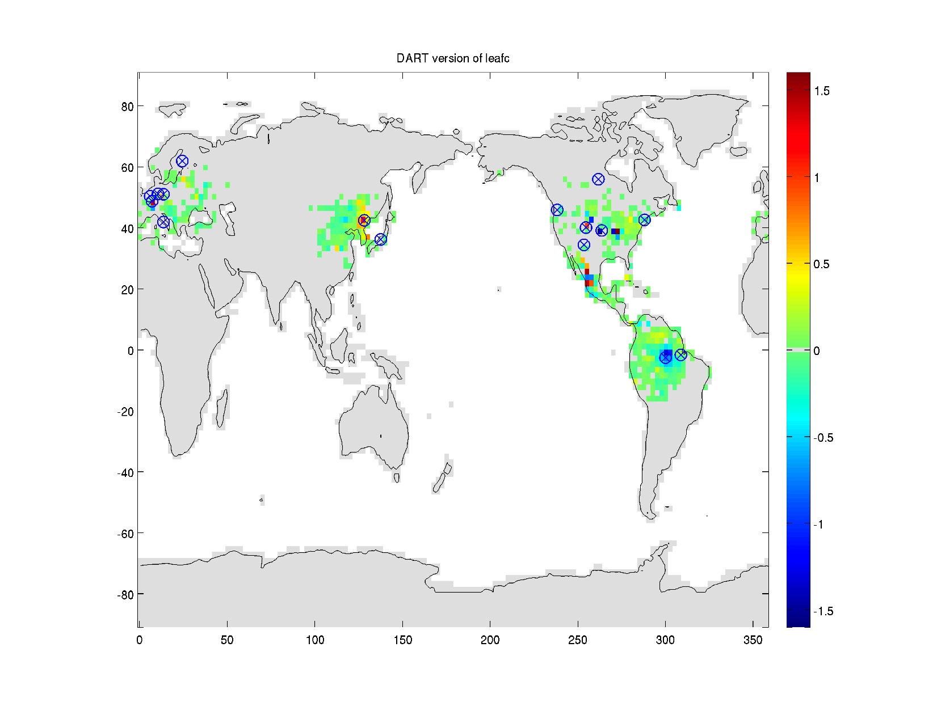
Innovation map of leafc on 4 May 2000
Information from a site is extrapolated across space through the covariance matrix represented by the ensemble of CLM instances.
Generally, largest updates closest to observation sites.
leaf
carbon

Slide 10
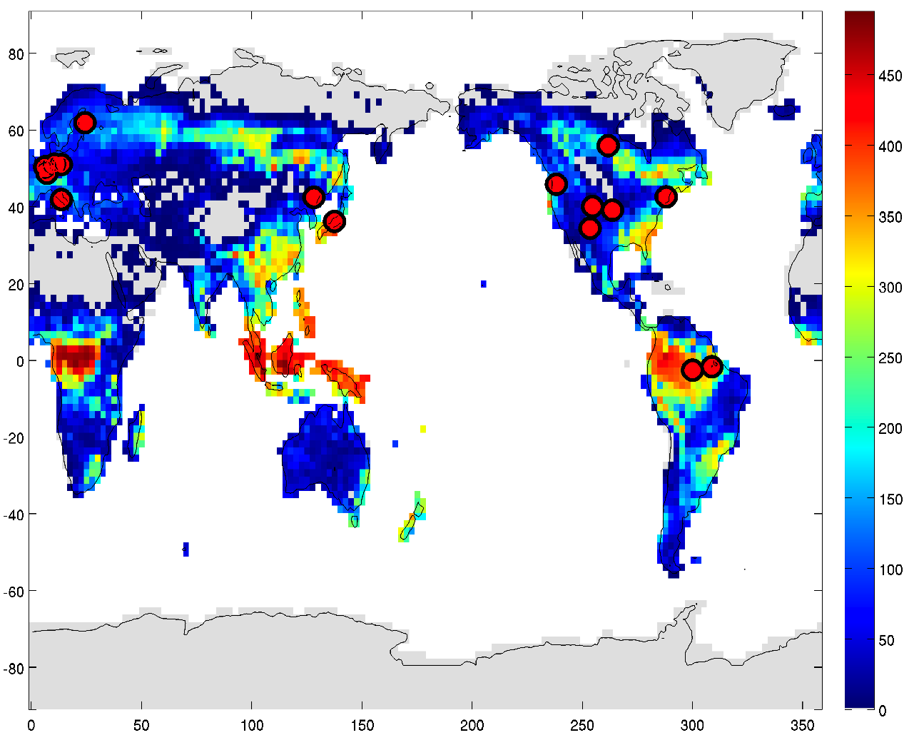
An example of data assimilation in the CLM
40 member ensemble of CLM forced with meteorology from 40 different data atmospheres in 2° grid global runs
Leaf carbon is a key variable in CLM strongly influencing productivity, evapotranspiration and radiation dynamics
Run 1 ensemble member forward from 1 May 2000, harvesting daily observations of leafc at 16 FLUXNET locations
Run 40 ensemble members forward from 1 May 2000 for 30 days, assimilating synthetic observations
Global leafc, 1 May 2000

Slide 11
Proof-of-concept with leaf carbon
Prior and posterior probability distributions of leaf carbon in a single grid cell at 60°W, 4°S for nine days of assimilation
Notes:
Starting from a ‘spun up’ global CLM case for year 2000 we advance a 40-member ensemble of the global model for 120 days. Each instance of CLM is coupled with an individual from an ensemble of data-atmospheres. A single instance of CLM from the ensemble is then assigned to be the ‘truth’ and run forward. Daily ‘observations’ of leaf carbon (leafc) are collected at sites (grid cells) across the globe by adding Gaussian noise to the actual leafc state at these locations. These ‘observations’ are then assimilated by DART as the whole 40-member ensemble is run forward. Obs error variance is 10, cutoff is 1.0 radian … huge.

Slide 12
Time series of “truth”, obs and 40 ens members
40 member ensemble of leafc in a single grid cell corresponding to 60.21°W, 2.61°S (Manaus, Brazil).
Ensemble members (blue lines) show impact of assimilation.
Andy has a CSL proposal for 420,000 core-hours on Yellowstone to continue.

Slide 13
CESM/CLM DART logic
CESM advances CLM to some time when we have observations – and STOPS.
This is done through the normal CESM framework: env_run.xml
A call to a DART shell script “assimilate.csh” is made.
DART makes a ‘clean’ directory in the CESM $RUN directory
The valid time of the model is determined and the appropriate file containing the observations is linked to a static file name – IMPORTANT.
DART makes a directory for each CLM instance and converts the CLM restart file to a DART initial conditions file – serially, but simultaneously.
‘filter’ runs and performs the assimilation on the DART initial conditions files and writes out DART restart files.
A subset of the information in the DART restart files is used to update the CLM restart files. Ask me why. Again – serially, but simultaneously.
The CESM ccsm_postrun.csh script executes as normal.
It may advance the model
It may call the short-term archiver
… whatever you told it in env_run.xml

Slide 14
Details
DART allows you to choose what CLM variables get updated by the assimilation.
&clm_vars_nml
clm_state_variables = 'frac_sno', 'KIND_SNOWCOVER_FRAC',
'DZSNO', 'KIND_SNOW_THICKNESS',
'H2OSNO', 'KIND_SNOW_WATER’,
'T_SOISNO', 'KIND_SOIL_TEMPERATURE',
‘leafc’, ‘KIND_LEAF_CARBON’ /
These are read from a CLM restart file and reinserted after the assimilation.
Potential problem … balance/consistency?
Notes:
The only information we need from our black box is what variables are available for the assimilation.
Right now CLM does not use netCDF metadata to define MISSING values, etc., so a big problem right now is to make sure we are not creating increments based on MISSING values.

Slide 15
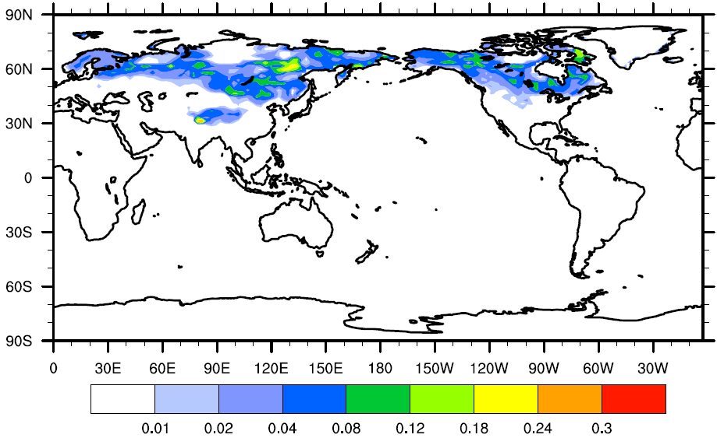
Assimilation of MODIS snow cover fraction
80 member ensemble for onset of NH winter
Assimilate once per day
Level 3 MODIS product – regridded to a daily 1 degree grid
Observation error variance is 0.1 (for lack of a better value)
Observations can impact state variables within 200km
CLM variable to be updated is the snow water equivalent “H2OSNO”
Standard deviation of the CLM snow cover fraction initial conditions for Oct. 2002
Notes:
This is a result from an experiment by Yongfei to assimilate MODIS observations of snow cover fraction on the UT system ‘lonestar’.
Instead of 3 ensemble members as in the schematic, she is using 80 instances of CLM, each with a unique atmospheric forcing.
A single CLM state from 1 Jan 1998 was replicated 80 times and then spun up with DART/CAM coupler DATM files through the end of October, 2002.
This is the standard deviation of the CLM snow cover fraction at the onset of the Northern Hemispere winter – the start of her assimilation experiment.
Yongfei is exploring the effect of assimilating MODIS snow cover fraction on the CLM snow water equivalent.

Slide 16
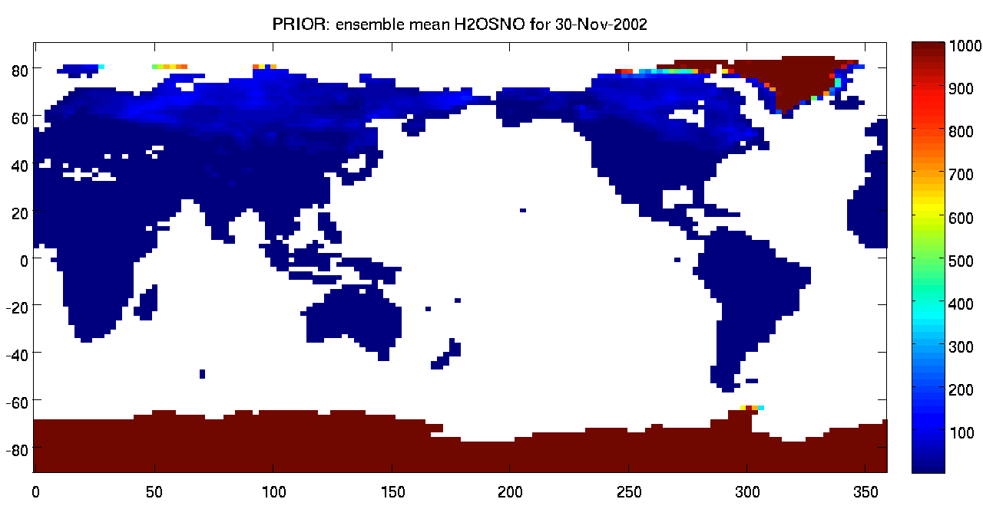
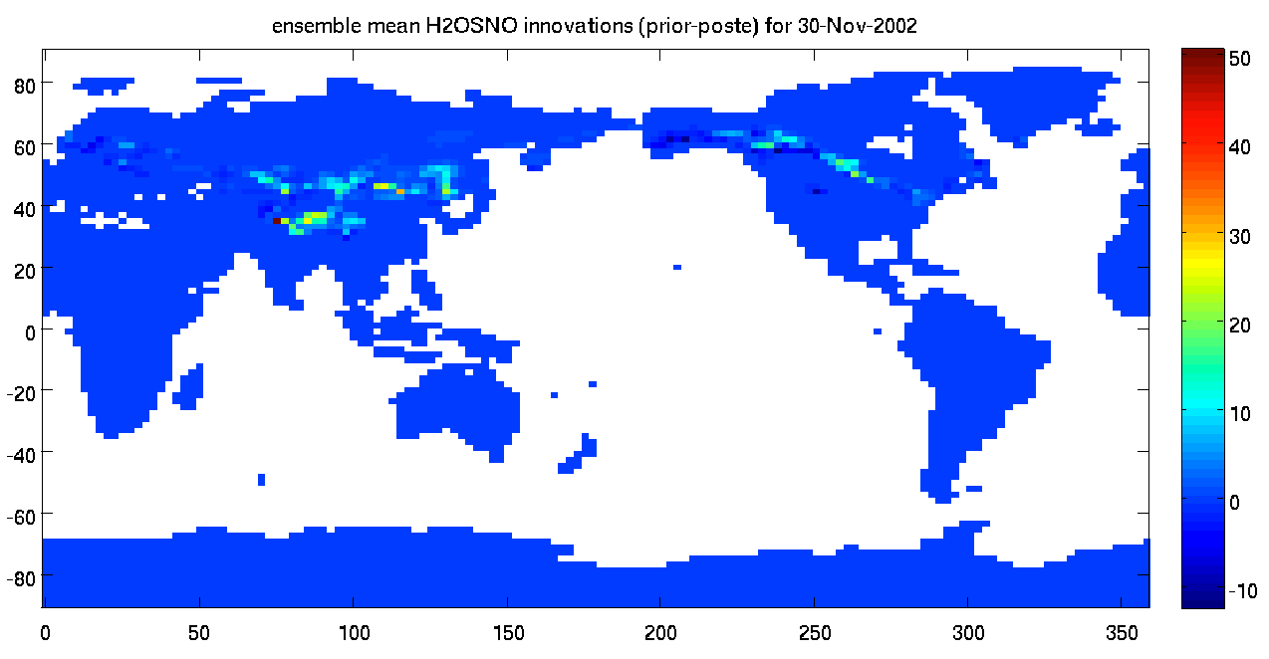
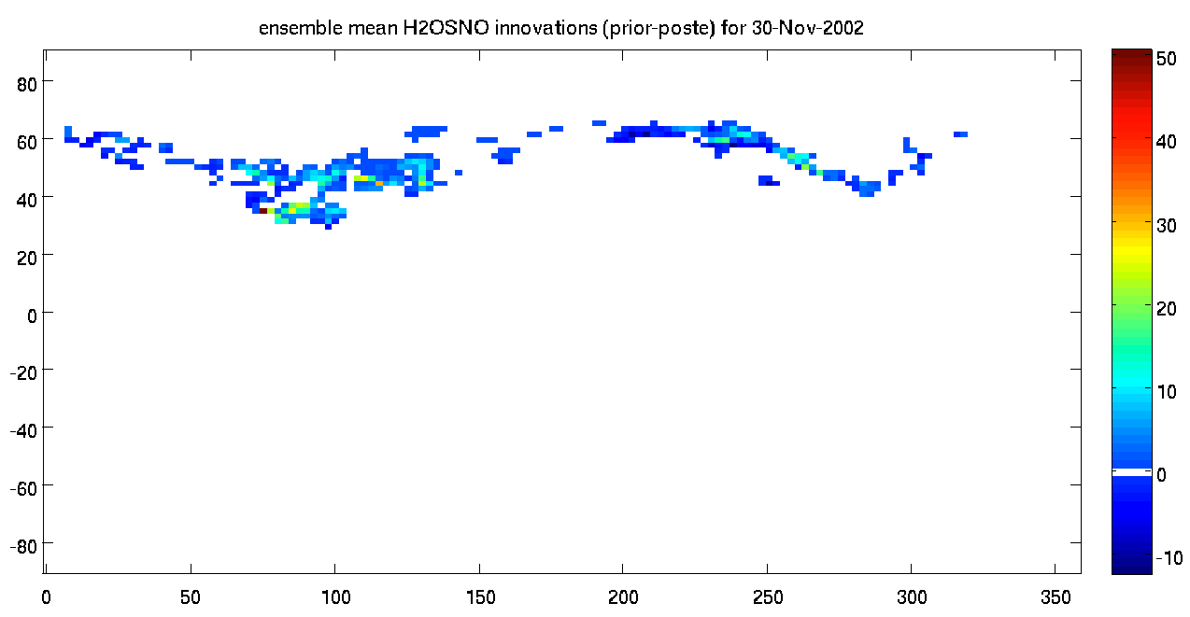
An early result: assimilation of MODIS snowcover fraction on total snow water equivalent in CLM.
Thanks Yongfei!
kg/m2
Prior for Nov 30, 2002
kg/m2
Increments (Prior – Posterior)
Focus on the non-zero increments
The model state is changing in reasonable places, by reasonable amounts. At this point, that’s all we’re looking for.
Notes:
80 member ensemble … 0.03 cutoff … gridded MODIS obs of uncertain origin …
Assimilation started on 1 Nov 2002
The only CLM variable to be updated was total snow water equivalent.
The CLM “frac_sno” variable was used by the forward operator.
In the instances where some/all of the ensemble members were missing … the assimilation did nothing … this is my definition of “simple”.

Slide 17

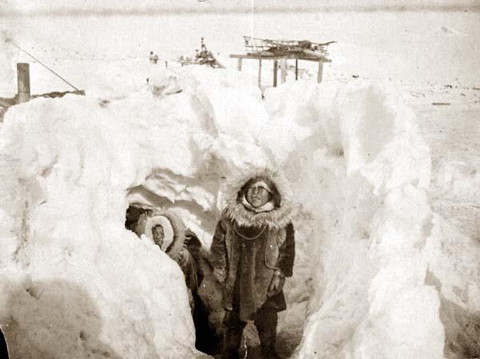
The HARD part is: What do we do when only SOME (or none!) of the ensembles have [snow,leaves,…] and the observations indicate otherwise?
Corn Snow?
Sugar Snow?
Wet Snow?
New Snow?
Dry Snow?
“Champagne Powder”?
Crusty Snow?
Slushy Snow?
Old Snow?
Dirty Snow?
Early Season Snow?
Packed Snow?
Snow Density?
Snow Albedo?
The ensemble must have some uncertainty, it cannot use the same value for all. The model expert must provide guidance. It’s even worse for the hundreds of carbon-based quantities!
Notes:
The CLM state vector has tens of variables pertaining to snow … what ones do we update, and how? In the case of snow … a thin layer can appear/disappear based on small differences in atmospheric forcing. Does the observation indicate we still have a little dirty snow left, or did it just snow a little? There are also some challenging observations … generally our observation is instantaneous, but there are observations out there of change in [carbon,water] over monthly timescales. Now we need the model state from a month ago in addition to the current state … our previous diagram is a little overly simplistic for this case.

Slide 18
What can CLM-DART do right now:
Use the CESM multi-instance capability to run simultaneous instances of CLM.
Force each instance with different realistic atmospheric conditions (say, from an offline CAM/DART assimilation).
Assimilate observations every time CESM stops.
Modify the CLM restart file contents to be more consistent with observations – and not just at the observation location!
Use CLM history files to provide model states to compare with observations, i.e. the observation operator IS the history file (GRACE observations, NEE, … ).

Slide 19
What can CLM-DART do right now:
Use the CESM multi-instance capability to run up to 80 simultaneous instances of CLM
Force each instance with different realistic atmospheric conditions (from an offline CAM/DART assimilation)
Use the multi-instance capability to assimilate every midnight
Modify the CLM restart file contents to be more consistent with observations – and not just at the observation location
Can use CLM history files to provide model states to compare with observations, i.e. the observation operator IS the history file (GRACE observations, NEE, … )
Defeat any (and all?) balance checks Erik can throw at us …
Blow your file quota on any machine, any time, without breaking a sweat …

Slide 20
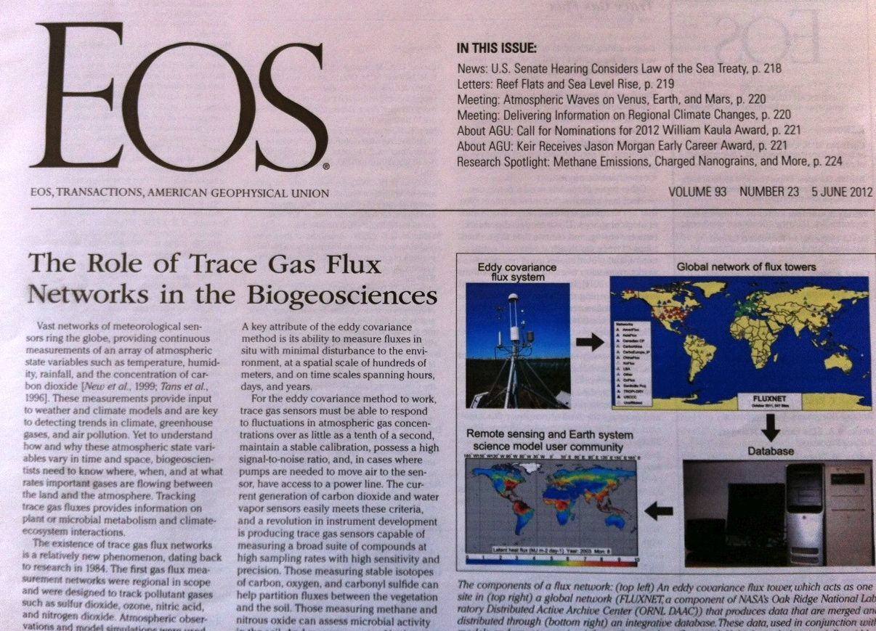
Notes:
We have support for ‘level4’ FLUXNET format tower observations – every 30 minutes.
The observation operator exploits a CLM history file to get the model state for NEP at
times that match the FLUXNET obs.

Slide 21
Observation support / Forward operators
There is a clean separation between DART, the model, and the observations.
This allows for modular support of multiple models and multiple forward operators, and a tremendous amount of code reuse. The same code is used to assimilate with the Lorenz ‘63 model as is used with every other model. The same observation datasets can be used with regional or global models,
data denial experiments, etc.
This is a list of the modules used to support different observation types:
obs_def_1d_state_mod.f90 | obs_def_GWD_mod.f90 | obs_def_simple_advection_mod.f90
obs_def_AIRS_mod.f90 | obs_def_metar_mod.f90 | obs_def_TES_nadir_mod.f90
obs_def_altimeter_mod.f90 | obs_def_ocean_mod.f90 | obs_def_tower_mod.f90
obs_def_AOD_mod.f90 | obs_def_pe2lyr_mod.f90 | obs_def_upper_atm_mod.f90
obs_def_cloud_mod.f90 | obs_def_QuikSCAT_mod.f90 | obs_def_vortex_mod.f90
obs_def_dew_point_mod.f90 | obs_def_radar_mod.f90 | obs_def_wind_speed_mod.f90
obs_def_gps_mod.f90 | obs_def_reanalysis_bufr_mod.f90
obs_def_gts_mod.f90 | obs_def_rel_humidity_mod.f90

Slide 22
Problems to be solved:
Proper initial ensemble
Creating snow with the right characteristics
Bounded quantities
When all ensembles have identical values the observations cannot have any effect with the current algorithms
Forward operators – many flux observations are over timescales that are inconvenient – need soil moisture from last month and now…
CLM has a lot of carbon species, hard to support all the forward operators required
CLM’s abstraction of grid cells, land units, etc., make the treatment of observations very peculiar. All land units in a grid cell share a location. Easy to have ‘contradictory’ observations.

Slide 23
For more information:
www.image.ucar.edu/DAReS/DART
dart@ucar.edu

Slide 25
A generic ensemble filter system like DART needs:
1. A way to make model forecasts;
2. A way to compute the observation operators, h.
The increments are regressed onto as many CLM state variables as you like. If there is a correlation, the CLM state gets adjusted in the restart file.
CLM instances
Notes:
This is a schematic – for clarity it has 3 ensemble members, we typically run wit 40 to 80 ensemble members.
I’m going to use the terms ‘ensemble members’, ’instances’, and ‘model states’ interchangeably.
The instances advance to some time when we want to assimilate some data, CLM writes out a bunch of restart files at time ‘t’.
DART grabs some subset of interest of the restart file to create a DART statevector.
DART applies an observation operator to get the expected value of an observation given the state.
These expected observations are compared to the observation that contains observation error, instrument error, representativeness errors … whatever.
All observations are imperfect.
Increments are calculated and then regressed onto the DART statevector.
The DART statevector elements are then inserted back into the CLM RESTART FILE.
We are not estimating parameters – YET. We are updating the actual CLM state, not the CLM parameters.
The whole point (to me) is that – after cycling the assimilation cycle “a few time” – CLM will represent June 19th 2012 instead of some arbitraryJune 19th.
Now you can do ecological forecasting.
Now you can compare the water storage from a GRACE observation to the water storage estimated by CLM for that day/week …

Slide 26
History file games:
cat << EOF >! user_nl_clm
&clm_inparm
hist_empty_htapes = .false.
hist_fincl1 = 'NEP'
hist_fincl2 = 'NEP'
hist_nhtfrq = -24,1,
hist_mfilt = 1,48
hist_avgflag_pertape = 'A','A'
/
EOF
We can query a history file for the CLM state at
History Files

Slide 27
Niwot Ridge

Slide 28
slide held in reserve

Slide 29
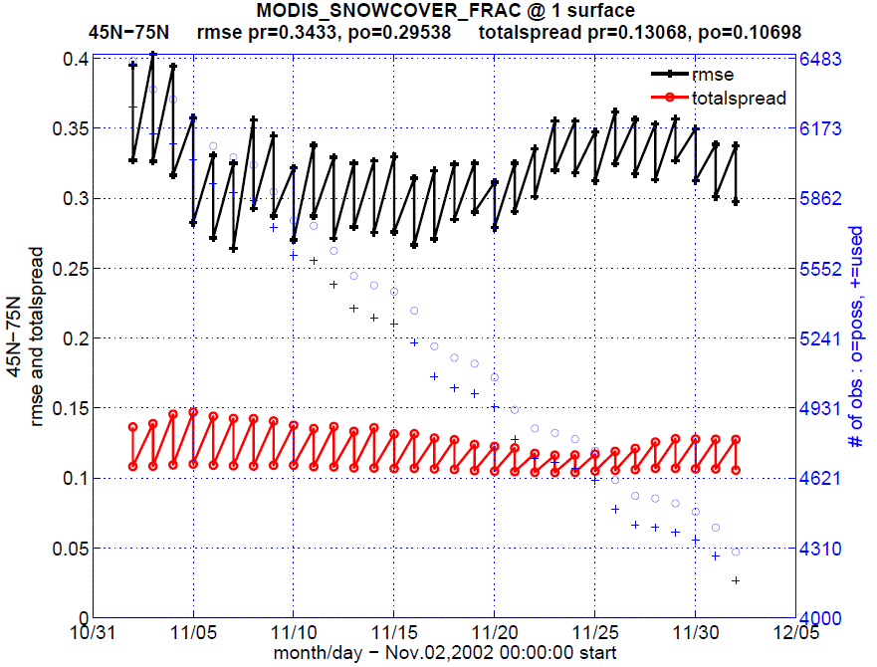
slide held in reserve

Slide 30
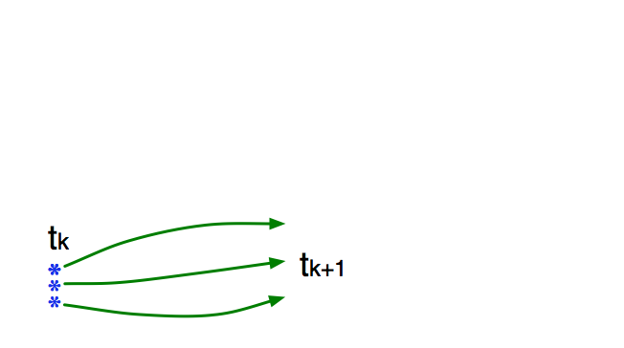
Ensemble Filter for Large Geophysical Models
1. Use model to advance ensemble (3 members here) to time at which next observation becomes available.
Ensemble state estimate after using previous observation (analysis)
Ensemble state at time of next observation (prior)

Slide 31
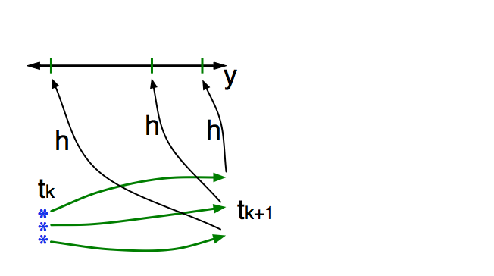
Ensemble Filter for Large Geophysical Models
2. Get prior ensemble sample of observation, y = h(x), by applying forward operator h to each ensemble member.
Theory: observations from instruments with uncorrelated errors can be done sequentially.

Slide 32
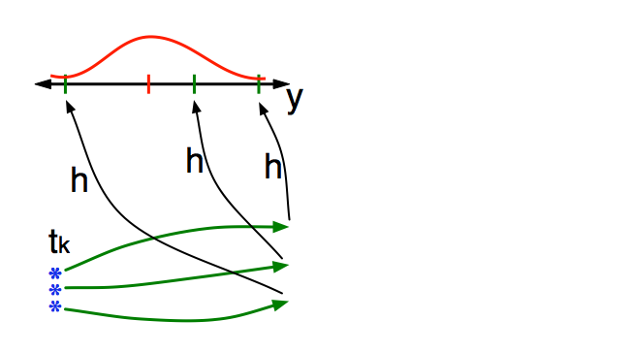
Ensemble Filter for Large Geophysical Models
3. Get observed value and observational error distribution from observing system.

Slide 33
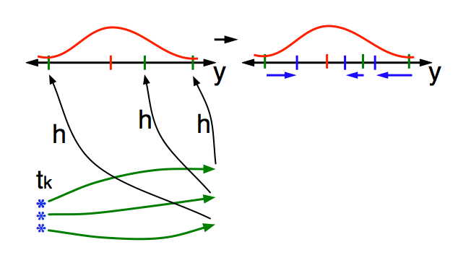
Ensemble Filter for Large Geophysical Models
4. Find the increments for the prior observation ensemble (this is a scalar problem for uncorrelated observation errors).
Note: Difference between various ensemble filters is primarily in observation increment calculation.

Slide 34
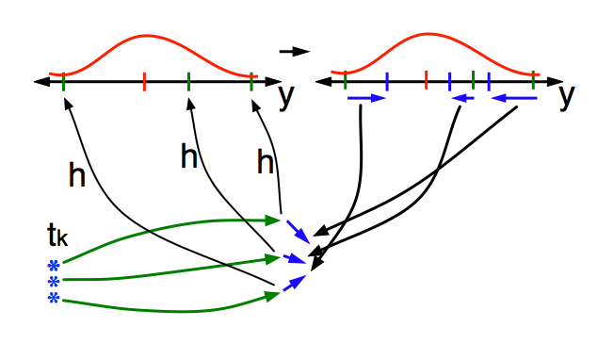
Ensemble Filter for Large Geophysical Models
5. Use ensemble samples of y and each state variable to linearly regress observation increments onto state variable increments.
Theory: impact of observation increments on each state variable can be handled independently!

Slide 35
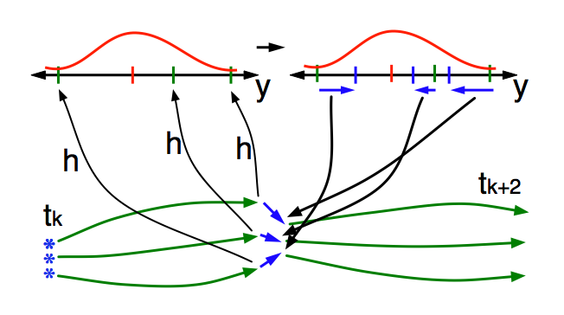
Ensemble Filter for Large Geophysical Models
6. When all ensemble members for each state variable are updated, there is a new analysis. Integrate to time of next observation …

